Slide 1
MEDICAL IMAGE CLASSIFICATION FOR DISEASE DETECTION
PRESENTED BY – PRATEEK MEHRA

Slide 2
OUTLINE
Problem Statement
System Approach
Algorithm and Deployment
Results
Conclusions
Future Scope
References

Slide 3
PROBLEM STATEMENT
🩺 Disease Detection from Medical Images Using Deep Learning
The objective is to develop a deep learning model to classify medical images (e.g., chest X-rays) to detect diseases such as pneumonia automatically and accurately. Early and reliable disease detection from medical images can assist healthcare professionals in diagnosis and treatment planning, especially in resource-constrained settings.
The task involves:
Loading and preprocessing medical images by resizing and normalizing pixel values for model readiness.
Splitting the dataset into training, validation, and test sets to evaluate the model reliably.
Building and training a Convolutional Neural Network (CNN) using frameworks like TensorFlow or PyTorch for feature extraction and classification.
Applying data augmentation techniques (flipping, rotation, zoom) to improve generalization and prevent overfitting.
Evaluating the model using metrics such as accuracy, precision, and recall, and visualizing misclassifications to understand the model’s failure points.

Slide 4
SYSTEM APPROACH
🖥️ System Requirements
✅ IDE:
Google Colab with T4 GPU for accelerated deep learning training.
✅ Libraries and Modules Used:
NumPy & Pandas For data loading, manipulation, and preprocessing.
Seaborn & Matplotlib For data visualization, exploratory analysis, and plotting model performance.
KaggleHub: For importing and managing datasets efficiently.
PIL (Python Imaging Library) For image loading, resizing, and visualization.
TensorFlow For building and training Convolutional Neural Networks (CNNs) for medical image classification.
Scikit-Learn For model evaluation using metrics like accuracy, precision, recall, and confusion matrix.

Slide 5
ALGORITHM AND DEPLOYMENT
🚀 Workflow
1️⃣ Dataset Loading
Imported Chest X-ray dataset using KaggleHub directly into the Colab environment.
2️⃣ Dataset Structure
Dataset organized into train, test, val directories, each further sub-categorized as Normal and Pneumonia.
3️⃣ Data Organization & Visualization
Created separate directories for each class and visualized sample images to understand patterns.
4️⃣ Data Scaling & Augmentation
Applied image scaling and augmentation (rotation, zoom, flips) on training data using ImageDataGenerator to improve generalization.
5️⃣ Preprocessing & Resizing
Resized images to (150, 150) and separated them into training, testing, and validation sets.

Slide 6
ALGORITHM AND DEPLOYMENT
6️⃣ Model Building
Built a Sequential CNN using:
Conv2D and MaxPooling2D layers
Hidden layer filters: [32, 64, 128, 256]
Total parameters: ~1,995,649
7️⃣ Model Training
Training setup:
Learning rate: 0.000001
Epochs: 15
Batch size: 32
8️⃣ Model Performance
Achieved 92% accuracy on the testing set.
9️⃣ Evaluation & Analysis
Created a Dataframe with testing data and predicted labels.
Visualized the confusion matrix.
Out of total 79 misclassifications, 5 cases were classified as normal while the patients had pneumonia, indicating a priority focus area for further model tuning.

Slide 7
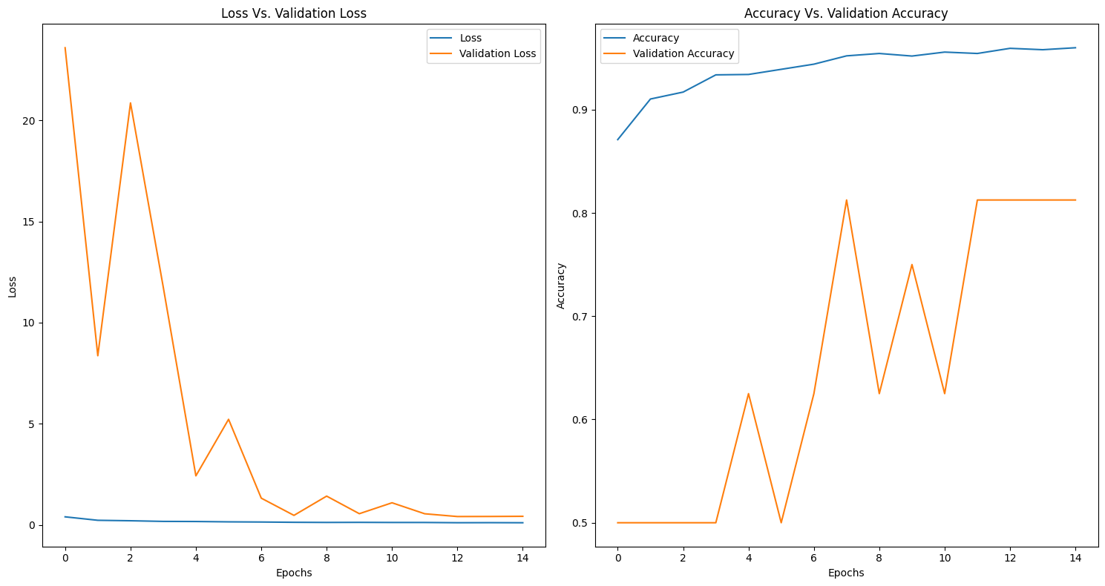
RESULTS
Validation Loss and Accuracy Graph Vs. Epochs
GitHub Link - https://github.com/WOLF-212121/Medical-Image-Classification-for-Disease-Detection-CNN-.git

Slide 8
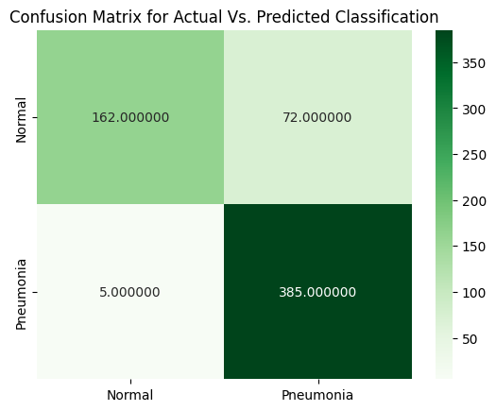
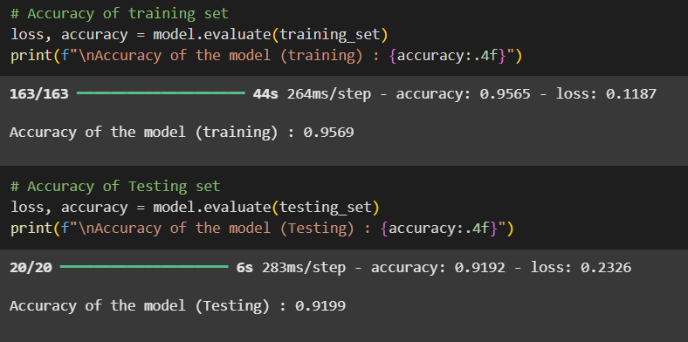

RESULTS
Accuracy Scores
Models Parameters
Confusion Matrix

Slide 9
CONCLUSIONS
The developed CNN model achieved a 92% accuracy on the testing set, demonstrating strong capability in classifying chest X-ray images for pneumonia detection.
During evaluation, the model produced 79 misclassified labels, of which 5 critical cases were incorrectly classified as 'Normal' while the patients had pneumonia. This highlights the importance of further fine-tuning and incorporating additional data or techniques to minimize false negatives, ensuring higher reliability for clinical deployment.
Overall, the project demonstrates the potential of deep learning for automated, efficient, and accurate medical image analysis to assist healthcare professionals in early pneumonia detection.

Slide 10
FUTURE SCOPES
1️⃣ Integration of Advanced Architectures
Using pre-trained models like VGG16, ResNet, or EfficientNet can improve feature extraction and accuracy for pneumonia detection.
However, these models are resource-intensive, and using them efficiently will require GPU optimization and possibly model pruning or quantization for deployment.
2️⃣ Expanding the Dataset
Adding more diverse and high-quality X-ray images will enhance the model’s learning capability, reduce overfitting, and improve generalization to unseen patient data.
3️⃣ Class Imbalance Handling
Techniques such as SMOTE, weighted loss functions, or oversampling can further reduce false negatives, particularly for critical pneumonia cases.
4️⃣ Explainable AI Integration
Implementing Grad-CAM or saliency maps can help visualize regions of X-ray images influencing the model’s predictions, enhancing trust for clinical use.
5️⃣ Deployment as a Diagnostic Tool
The trained model can be deployed using TensorFlow Lite or ONNX for integration into healthcare systems, assisting radiologists in early, automated screening.
6️⃣ Multi-Disease Classification
Extending the model to detect additional chest diseases (e.g., tuberculosis, COVID-19) to build a comprehensive chest X-ray analysis system

Slide 11
REFERENCES
✅ Kaggle
Utilized datasets and kernels from Kaggle for chest X-ray images and initial data interpretation guidance.
✅ CNN Research Papers and Blogs
Referred to research papers and technical blogs on Convolutional Neural Networks (CNNs) for understanding model architecture, data augmentation, and optimization techniques relevant to medical image classification.

